Slide 1
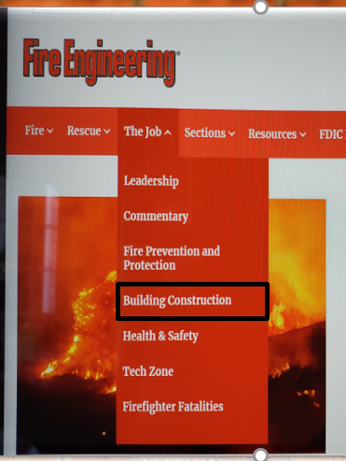
BUILDING CONSTRUCTION
&
FIREGROUND
OPERATIONS
Round table
Notes:
Opening slide

Slide 2
BUILDING CONSTRUCTION
&
FIREGROUND
OPERATIONS
PODCAST
Notes:
End of program slide show as we rap up

Slide 3
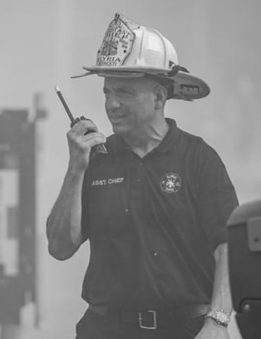
JOE PRONESTI
picture
JACK J. MURPHY

Slide 4
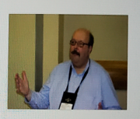
GLENN CORBETT
PAUL DANSBACH

Slide 5
JAMES JOHNSON
With Lexi Shady

Slide 6
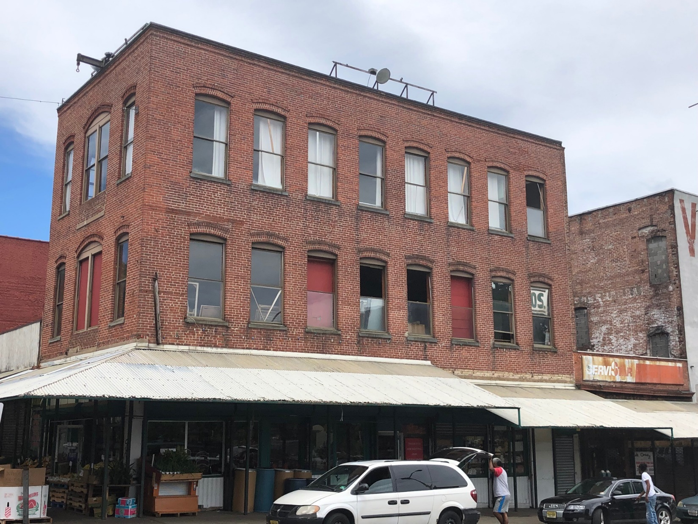
Notes:
Slide 1 GC
Title: GC:Legacy Type III is characterized by masonry (brick, stone) load-bearing walls with wood frame structural frame
Legacy Type III is characterized by masonry (brick, stone) load-bearing walls with wood frame structural frame
Type III Basics
Text:
Type III construction is one of five different buildings code classifications of construction

Slide 7
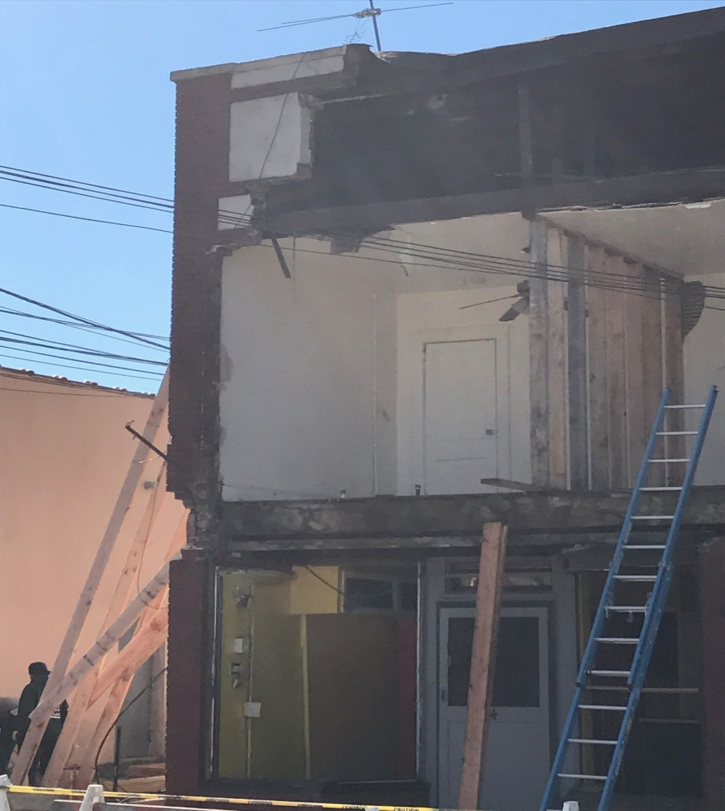
Notes:
GC:Legacy Type III is characterized by masonry (brick, stone) load-bearing walls with wood frame structural frame
Legacy Type III is characterized by masonry (brick, stone) load-bearing walls with wood frame structural frame

Slide 8
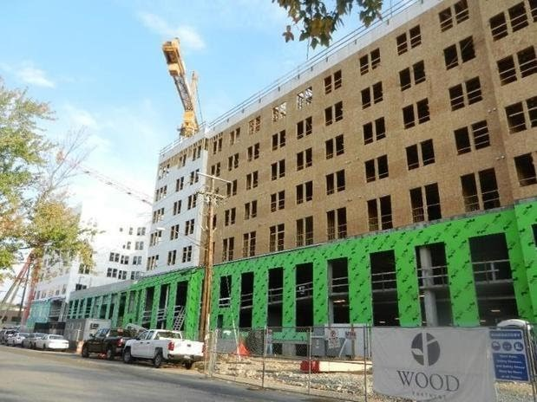
Credit: Matt Chibarro
Notes:
GCRecently, the International Building Code permitted the use fire-retardant treated wood as a substitute for masonry in exterior walls

Slide 9
Notes:
An issue that we commonly find in Type III buildings is void spaces. This can be from the original design and orientation of the structural members, drop ceilings, or from renovations or remodels.
JJ

Slide 10
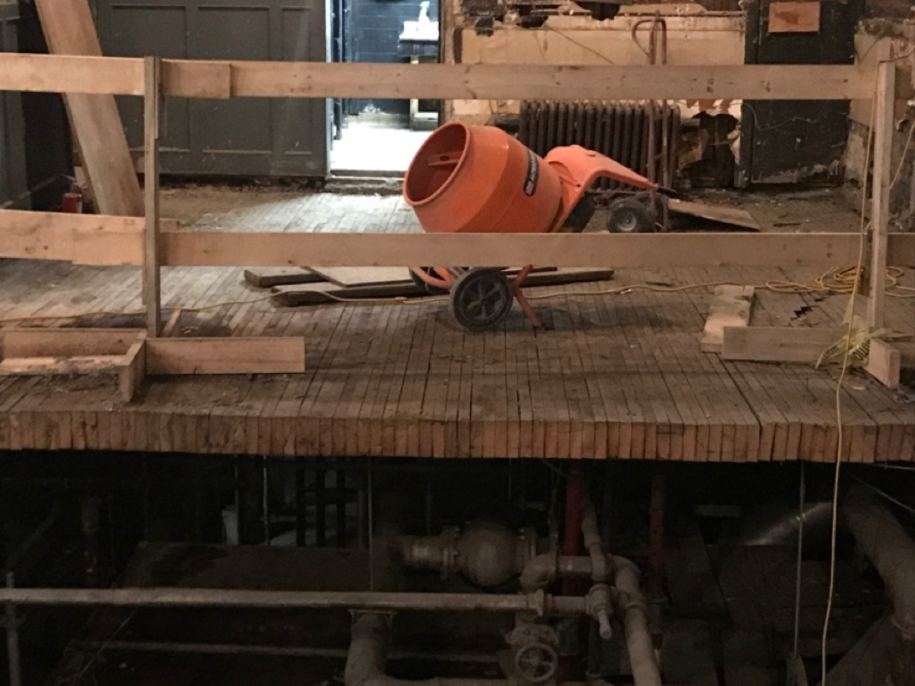
Notes:
Depending on where you are located in North America, Type III buildings may look quite a bit different. In British Columbia and many places in the Pacific Northwest where lumber has always been in abundance, these are the types of floor systems you may encounter. This is solid dimensional lumber, lined up on edge and nailed together, to form a solid floor system. This is very similar to what we are now seeing Mass Timber applications.

Slide 11
Notes:
The is another example of various void spaces, this can be in the ceiling, as well as on the walls. A common practice during renovations to deal with energy efficiency requirements is to build out the walls with wood or steel stud framing. This space will then be insulated and will provide the required R-Value for the occupancy type.
JJ

Slide 12
Notes:
This is an example of a roof void system. While the void space may appear to be original due to the type of timber trusses that are used, it is important to look for clues that may indicate renovations or remodels, such as the HVAC ducting.
JJ

Slide 13
Notes:
An important aspect to keep in mind with buildings is that many of them are already “sick” before a fire ever happens. It’s important that during our initial size-up, that we look for any signs of repair. Strongbacks like you see in this photo are examples of wall tie-backs that are used to repair failing buildings.
One useful size-up tip is to make sure to pay attention to the rear or ”C” side of the structure. Often during renovations, the owner will upgrade the appearance of the front of the building, but will not invest the time and money on the rear of the building. This is where we will most often see clues that the building is “sick”.
JJ

Slide 14
Notes:
Another key thing to look for in Type III buildings is tie plates like you see here. Often if in a uniform passion and spaced out equally, these are either part of the original design, or like on the West Coast where we see retrofit alterations due to seismic considerations. These are most often straps that connect the floor or roof joists to the exterior wall.
If you see plates that appear to be random or in a vertical arrangement, this is often wall tie-backs and a sign of pre-existing structural issues.
JJ

Slide 15
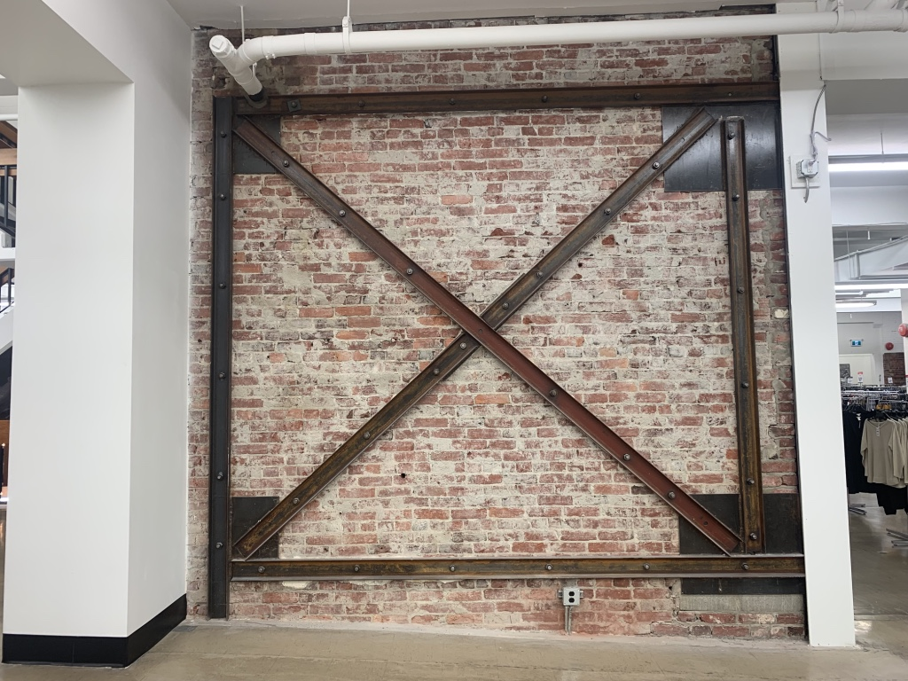
Notes:
This is an example of retrofit structural reinforcements that have been completed to bring the building up to a modern code. This is very common all along the West Coast.

Slide 16
Main Street America Buildings
Basement Concerns and Fire Problems
The following slides center around typical Main Street America occupancies of Ordinary (Type III) Construction, the occupancies are typically not large, may be one to three stories in height. When constructed the first floor was typically a mercantile occupancy, the rear of the first floor may have been occupied as a dwelling for the shop owner. The second and third floors were likely originally occupied as dwelling units. Later in the life if the building the second and third floors may have been converted to another use such as office occupancies or even left vacant as people moved away from the “downtown” areas.

Slide 17
Main Street America Buildings
Basement Concerns and Fire Problems …
As more people desire to live in “downtown” and in urban centers these dwelling units are being rehabilitated and occupied once again as dwelling units In the following slides we will review the concerns and fire problems associated with these occupancies. There are number of building and occupancies that all add up to making fires in the basements of these occupancy types challenging and dangerous to the responding firefighters.

Slide 18
Main Street America Buildings
Access To The Basement
Access via the interior stairway from the first floor may be the only way into the basement.
Interior stairways tent to be narrow, steep, the tread and risers may not be of uniform dimensions or code complaint conditions.
Identification of the interior stairway may be challenging is some occupancies, in a two or three story occupancy the basement stairway is typically located directly under or stacked on the stairway to the second floor.

Slide 19
Main Street America Buildings
Access To The Basement
Examples (photos with explanations)
55 Park Avenue
96 Park Avenue
72 Park Avenue
69-75 Park Avenue

Slide 20
Main Street America Buildings
Access To The Basement …
Exterior “Sidewalk” trap doors
The stairs may be more like a ships ladder that a stairway,
Stair may be at a steep angle, small stair treads and higher than normal risers
Can be utilized as a ventilation point
Difficult hose stretches
Rear doors, exterior stairways (at grade if grade changes or below grade)
Rear exterior doors tend to be more fortified than front doors
Steep stairs
Obstructions (69 Park Avenue Photo)
Can be utilized as a ventilation point
Difficult hose stretches

Slide 21
Main Street America Buildings
Limited Opportunity For Ventilation
If the interior stairway is the only opening to the basement it will also be the only point for ventilation
Makes hose stretch more difficult and dangerous.

Slide 22
Main Street America Buildings
Low Ceilings … Fire Load … Unprotected Wood Joists
These combination of factors may lead to rapid fire development, early flashover and burn-through of the floor deck and collapse of the floor assembly.
284 Park Avenue

Slide 23
Main Street America Buildings
Deep Basements
This feature has the potential to increase the amount of stored combustible and impact the ability to rescue trapped or disoriented firefighters.
Storage, shelving or store fixtures may create maze-line conditions.
72 Park Avenue

Slide 24
Main Street America Buildings
Utility Control
The natural gas and electric utilities are typically located along the “A: wall of the basement.

Slide 25
Main Street America Buildings
Vertical Fire Extension
Potential for vertical fire extension
Building utilizes such as drain, waste and vent pipes, water supply pipes
Light and air shafts that extended to the basement, may be difficult to identify and/or may have been sealed up through renovations
Photo 47 Park Avenue

Slide 26
Main Street America Buildings
Firefighter Tips
Always descend the stairs facing the stairs, backwards down the stairs
This puts your center of gravity facing the stairs and not down the stairs
Open riser stairs will provide a “grab surface” similar to the rungs of a ladder to help you navigate the stairs
Facing the stairs puts you in the right direction in the event you encounter untenable conditions that requires you retreat; you simply climb up the stairs no need to turn around as you are already facing the right direction to go up the stairs
Never stray from the hoseline or search rope

Slide 28
Type-3 Construction undergoing a major renovation project
when a fire occurred and quickly spread throughout the building

Slide 29
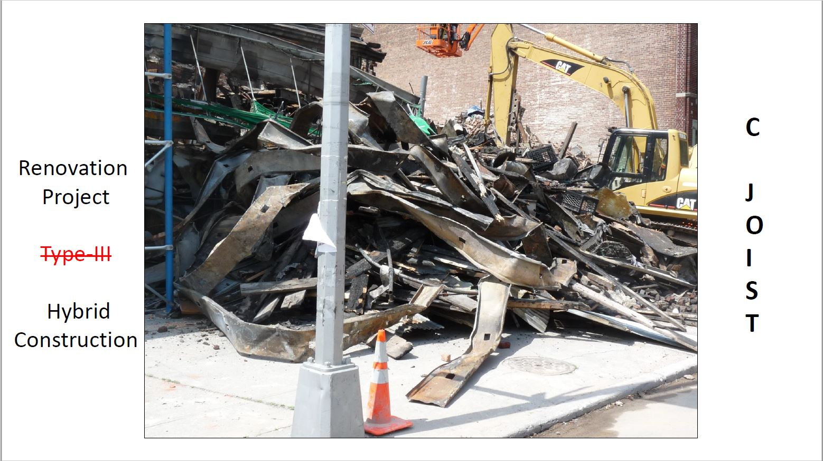
After the fire during demolition, it was revealed that the solid wood floor joists and roof rafters
have been replace with lightweight “C”-Joist. During the construction phases in your response
District get off the Rig and see if any construction methods give a RED FLAG if you had a fire here.

Slide 30
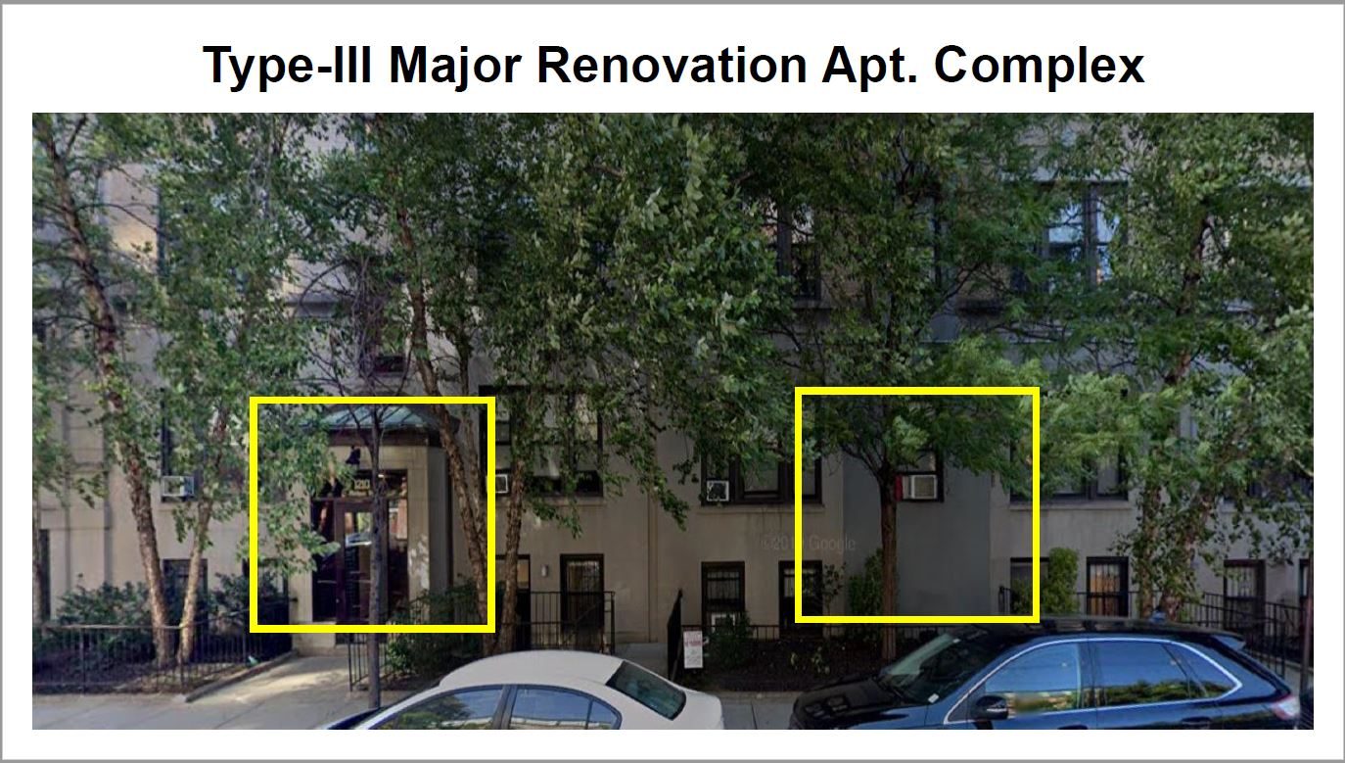
A typical urban low-rise housing complex (attached 5-story building). The YELLOW box on the left represents the old code where each attached building address had their own entrance. While the YELLOW box on the right represents the new code where several old exterior entrance doors were removed and the interior floor layout changed. See next slide for new floor patterns.

Slide 31
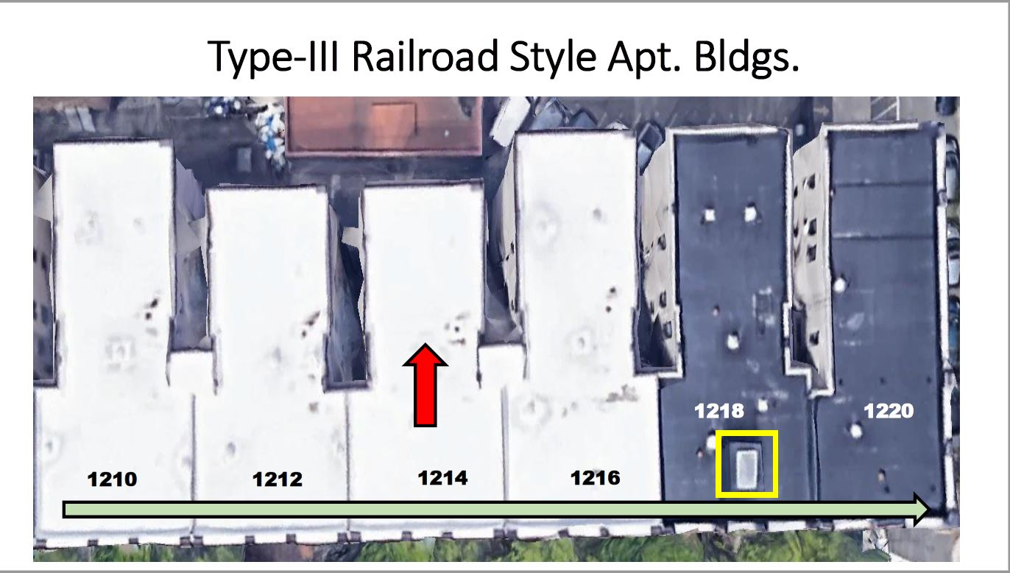
All address numbers on top of the roof represent the old code building entry points, and the RED arrow
indicates the apt. unit layouts going from the Side-A (front) to Side-B (rear) with 2 apt. units per floor. The GREEN arrow indicates the new code floor layout with apt. units going from Side-B (left) to Side-D Right). By doing this new pattern the architects were able to add 2 more apt units per floor. Just the bldg. addresses 1210 and 1216 remained as the new entrance points. With new construction comes better installation (buttoning up the bldg. from cold & hot weather with double pane windows, etc.) thus creating a different fire conditions.

Slide 32
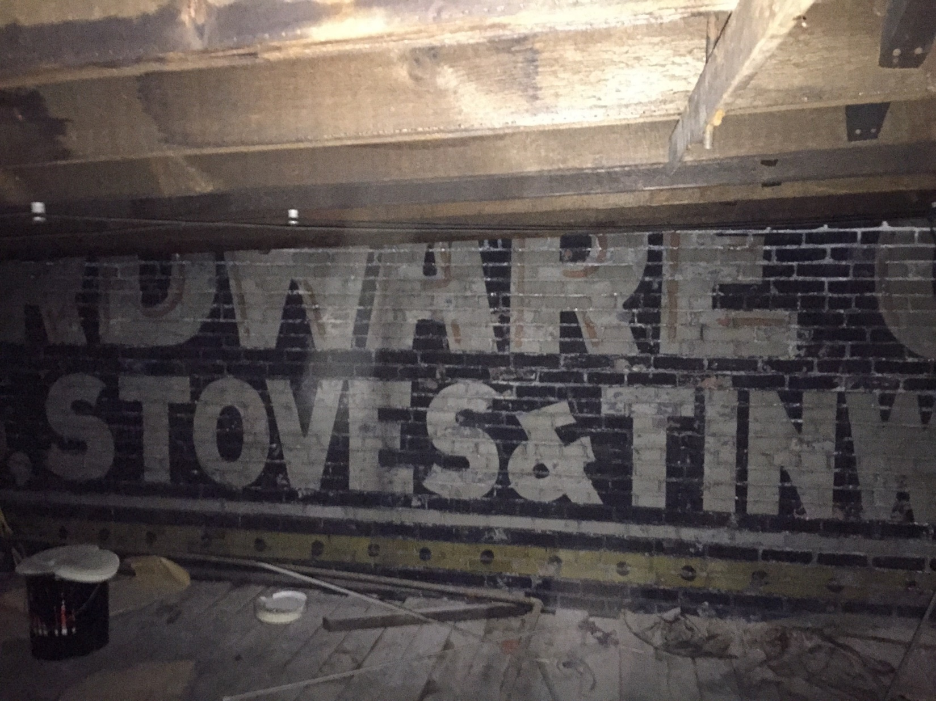
Fire Behavior and the Cockloft
Cocklofts
Notes:
A cockloft is a small space created when the roof is raised above the level of the flat beams to provide a pitch to drain rain and a vented air space to reduce top-floor temperatures.

Slide 33
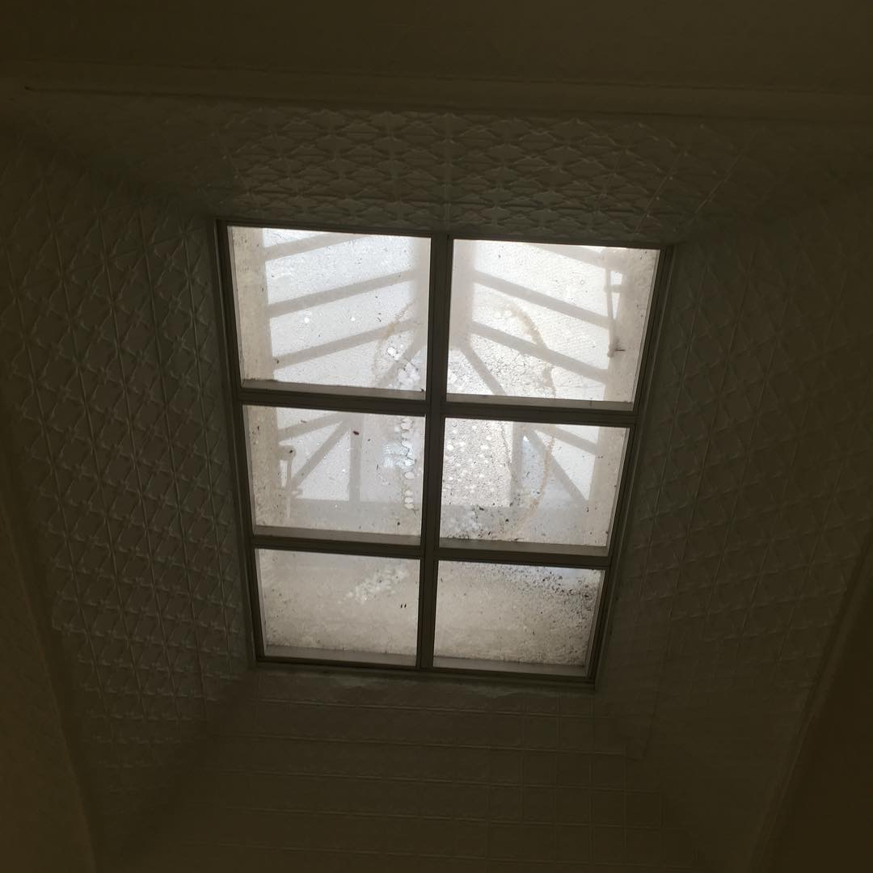
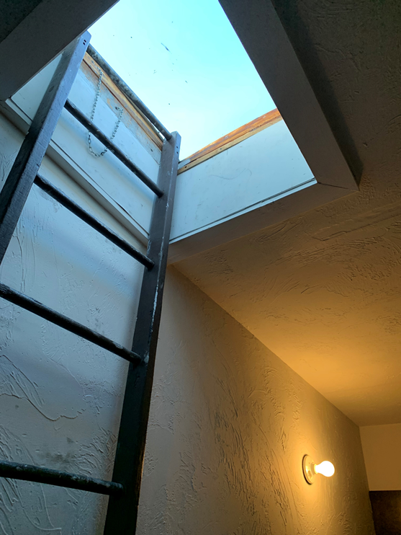
Notes:
Skylights are a prominent feature of a type III

Slide 34
Coping Stones & Caps
Notes:
The top of a masonry wall must have a top of some sort for moisture protection, these cornices and caps become lose over the years and only have gravity holding them on

Slide 35
Tar Cake Anyone??
Notes:
Roofs will have a build up layer tar over the years, vertical ventilation while a must, may be difficult.

Slide 36
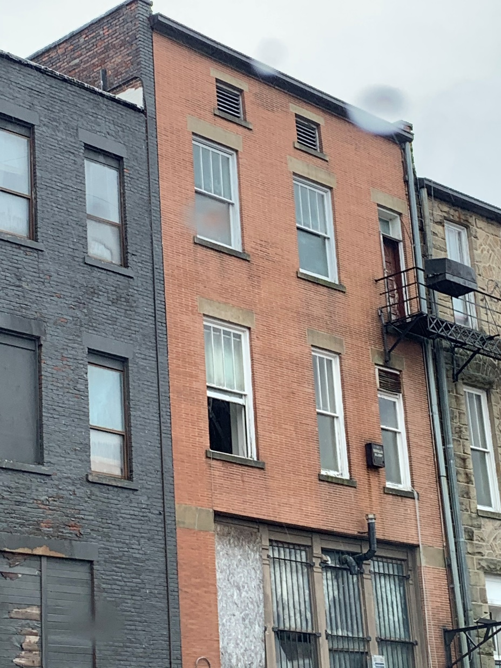
Notes:
Vents in the cockloft may lend themselves to exterior stream access

Slide 37
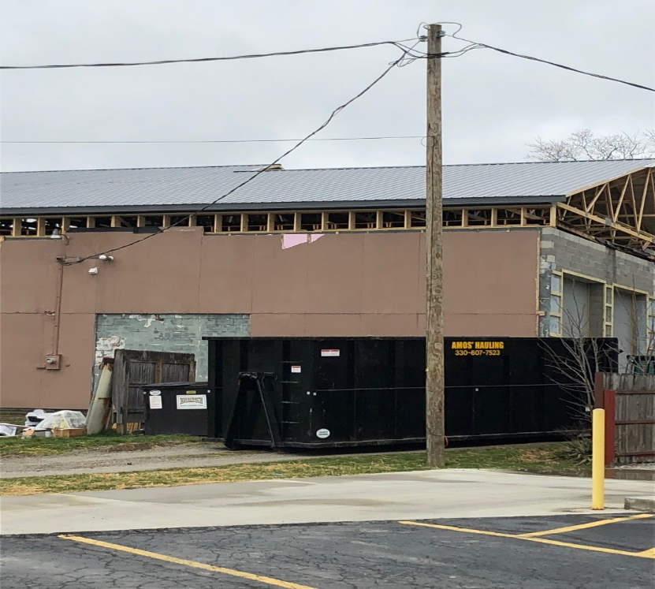
Rain Roofs
Notes:
A rain roof built on top of an original roof also causes less disruption of the operation of a building than repairing or replacing the original roof. An office or a multiple dwelling can continue to be occupied while the rain roof or second roof structure is constructed over the original roof.

